Slide 1
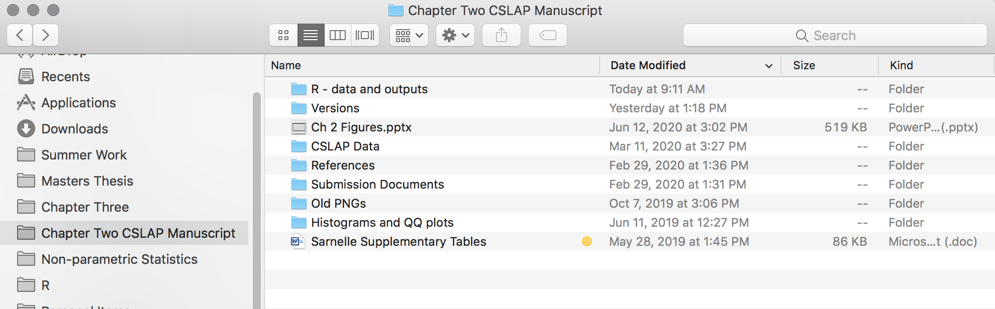
One catch-all folder for scripts, raw data, output data, figures, etc.
Main Folder for Ch. 2

Slide 2
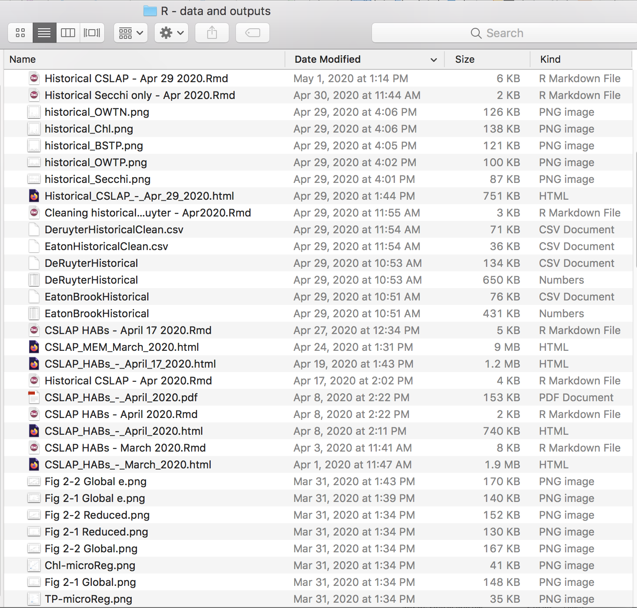
Output figures
Mixed raw data and processed data
Updated versions of same analyses

Slide 3
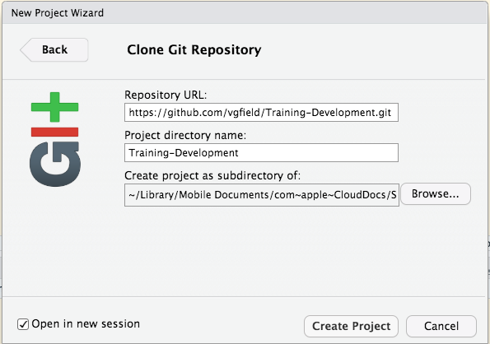
Paste URL here
This creates a new folder called “Training Development
Click this to orient yourself to the correct file pathway

Slide 4
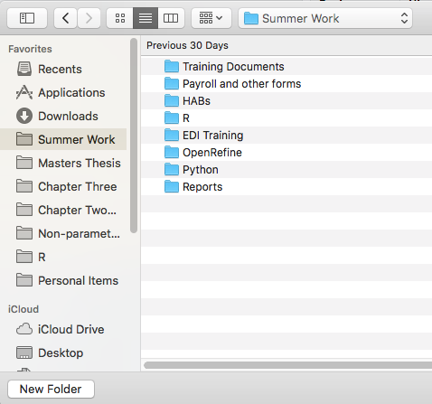
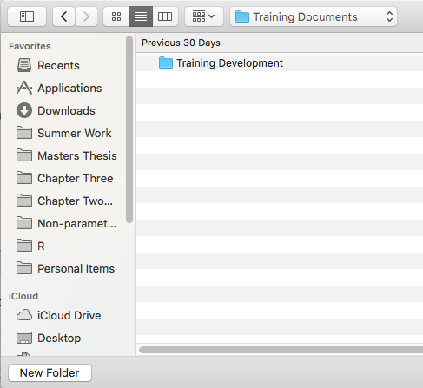

This is where I want my project to live
This folder is currently empty.
I already have main folder for Summer Work
This is the file pathway where I want to keep my new project
~/Library/Mobile Documents/com~apple~CloudDocs/Summer Work/Training Documents

Slide 5
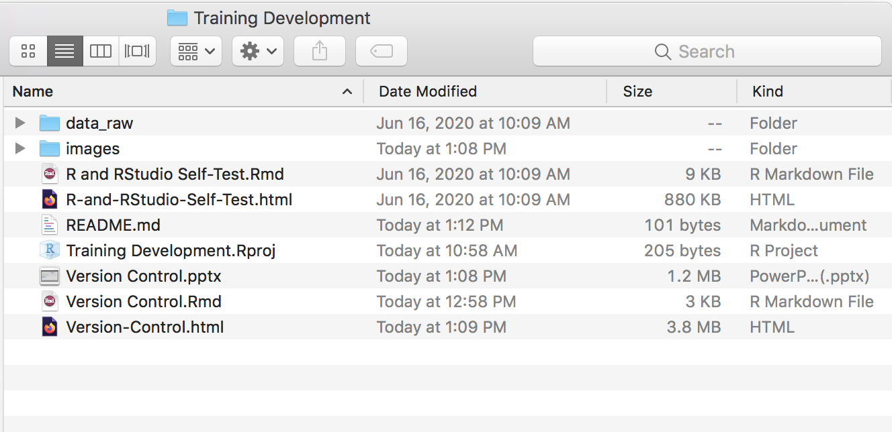
New folder
README file from GitHub
New R Project
Open the newly created folder to check out the content

